Slide 1

MONOREPOS
GOOD
THE
BAD
THE
UGLY
AND THE
Notes:
Hello
Who am I?
Why I’m qualified to give this talk
Quick survey of experience
What this talk will not be:
Adovating monorepos
Google/Facebook scale monorepos

Slide 2

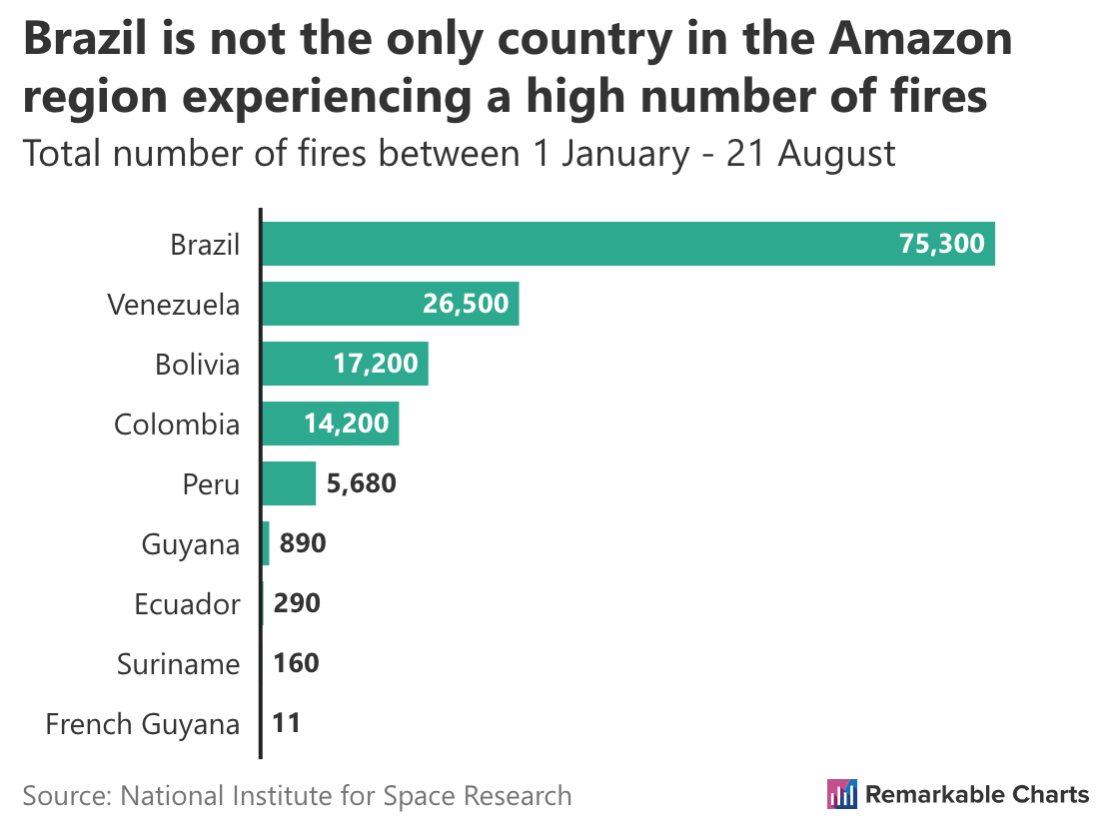
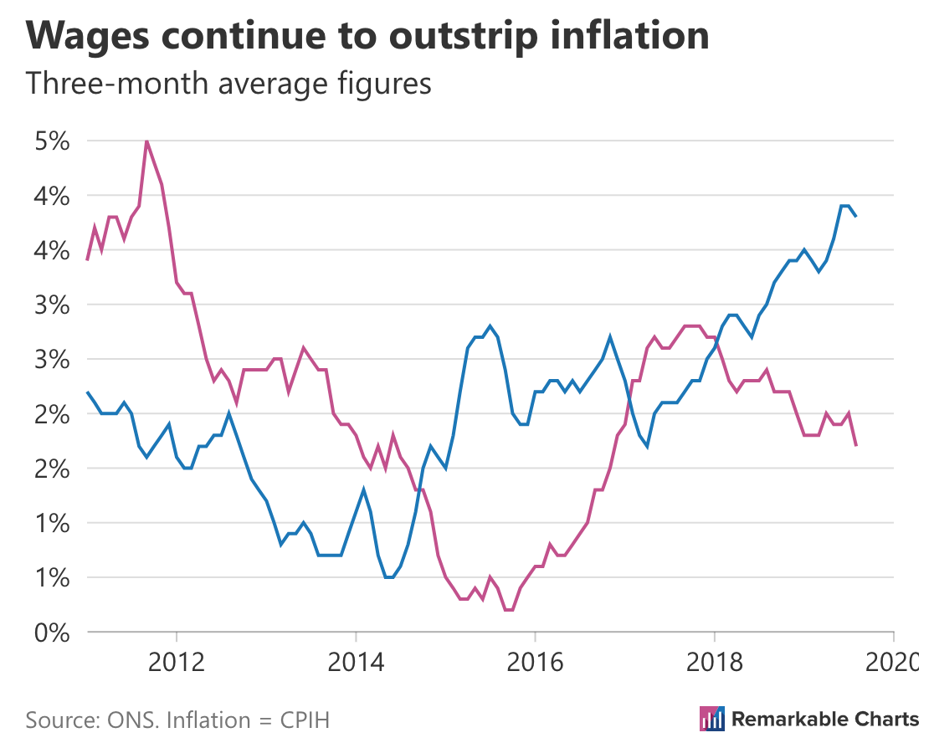

Notes:
Mention beard

Slide 3
The plan
The Good – why would I want one?
The Bad – what are the downsides?
The Ugly – how do I get one?
Notes:
The plan
Three parts: the Good, the Bad, and the Ugly

Slide 4
What is a monorepo?

Slide 5
Contains multiple packages or projects

Slide 6
Examples
React
Babel

Slide 7
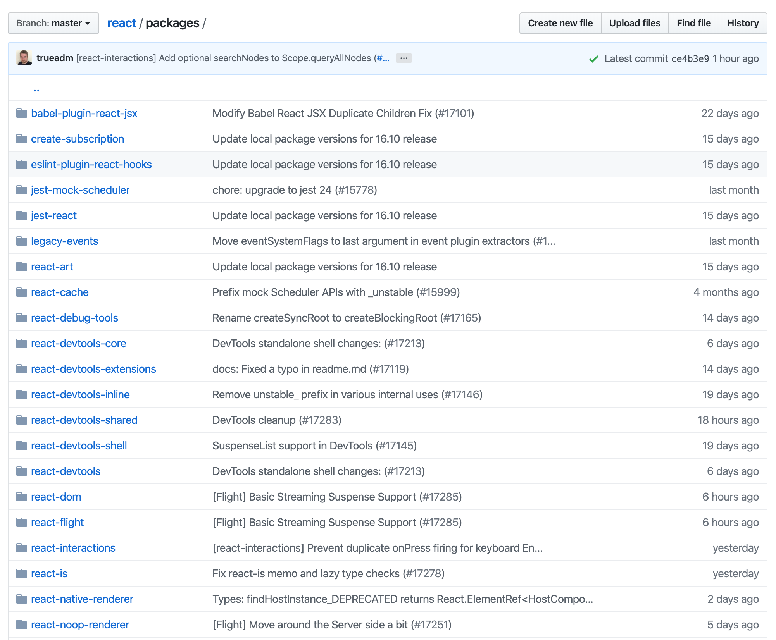

Notes:
Wont work at low res

Slide 8
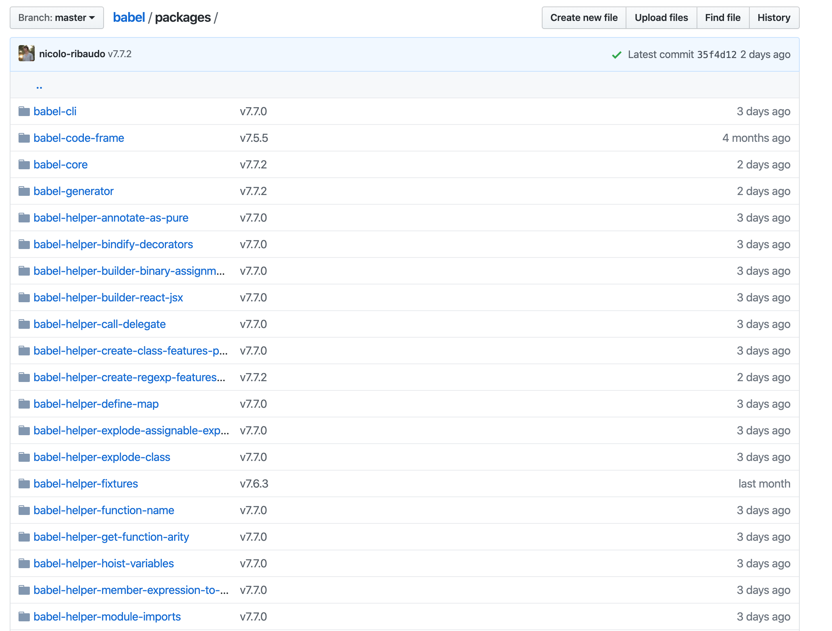
Notes:
https://github.com/babel/babel/tree/master/packages
Quick Baybel babble poll? ☺

Slide 9
Alternatives
Monolith
Multirepo

Slide 10
The Good

Slide 11
Why would I want one?
One development environment
Common configuration
Code reuse
Cross project changes
Single release process
Single culture

Slide 12
One development environment
Everything in one place
Backend and frontend
Easy to get started

Slide 13
Common configuration
Top level lint/prettier/babel
Less convention switching
No orphaned packages

Slide 14
Code reuse
Split common code into modules (cheat with npm link but it’s a PAIN)
Use and dependencies versioned
Breaking changes visible

Slide 15
Cross project changes
One PR for multi module features
One PR to review with full context
One PR to revert if it goes wrong

Slide 16
Single release process
Everything needed to build available
Everything needed to test available
Release/revert with confidence

Slide 17
Single culture
Software is easy
People are hard

Slide 18
The Bad

Slide 19
What are the downsides?
Bigger repo
Continuous delivery/deployment harder
Tooling less mature
Community and resources aren’t nearly as vast
Your organisation may just not be able to accommodate

Slide 20
Bigger repository
Content

Slide 21
Continuous delivery/deployment harder
Content

Slide 22
Tooling less mature
Content

Slide 23
Community and resources lacking
Content

Slide 24
Your organisation may just not be able to accommodate
Content

Slide 25
The Ugly

Slide 26
How do I get a monorepo?
Content

Slide 27
Incremental migration
Monolith -> monorepo
Multirepo -> monorepo (demo)

Slide 28
Npm link woes

Slide 29
Lerna
Lerna is a tool that optimizes the workflow around managing multi-package repositories with git and npm.

Slide 30
Yarn workspaces
Workspaces are a new way to setup your package architecture that’s available by default starting from Yarn 1.0. It allows you to setup multiple packages in such a way that you only need to run yarn install once to install all of them in a single pass.
Why would you want to do this?
Your dependencies can be linked together, which means that your workspaces can depend on one another while always using the most up-to-date code available. This is also a better mechanism than yarn link since it only affects your workspace tree rather than your whole system.
All your project dependencies will be installed together, giving Yarn more latitude to better optimize them.
Yarn will use a single lockfile rather than a different one for each project, which means fewer conflicts and easier reviews.

Slide 31
Resources
Blog posts
https://medium.com/@mattklein123/monorepos-please-dont-e9a279be011b
Websites
https://trunkbaseddevelopment.com/monorepos/
Notes:
Why not use local paths for dependencies? https://docs.npmjs.com/files/package.json#local-paths

